Slide 1
The Effect of ChemBlock Towards Memorizing of Chemical Mechanism
By Ahmad Farid B Yang Abd Talib dan Mohammad Hafizan B Mat Kamil

Slide 2
Abstract
A study on effect of ChemBlock towards memorizing organic chemistry mechanism was conducted with a group of 24 students from module 3 of Kolej Matrikulasi Sarawak. The group were the K4T7 and K4T8 classes were further divided into two group from each classes. Study shows that the Chemblock group were able to achieve 83% and 67% success rate for the 1st cycle. For the 2nd cycle the success rate was 67% and 50%. It can be concluded that ChemBlock were able to aid in helping students to memorize the organic mechanism.

Slide 3
Research objective
To investigate whether ChemBlock were able to help in students’ memorizing the organic mechanism
To investigate whether ChemBlock were able to affect students’ achievement in their final exam

Slide 4
Research sample
A study was done towards two groups of students with mixed learning abilities, K4T7 and K4T8 classes(Table 1). All the students were from Computer Science module which is Module 3. They were 24 students involved in the research.
Class | No. of students
K4T7 | 12
K4T8 | 12
ChemBlock group | Control |  | ChemBlock group | Control
K4T7a | K4T7b |  | K4T8b | K4T8a
6 students | 6 students |  | 6 students | 6 students

Slide 5
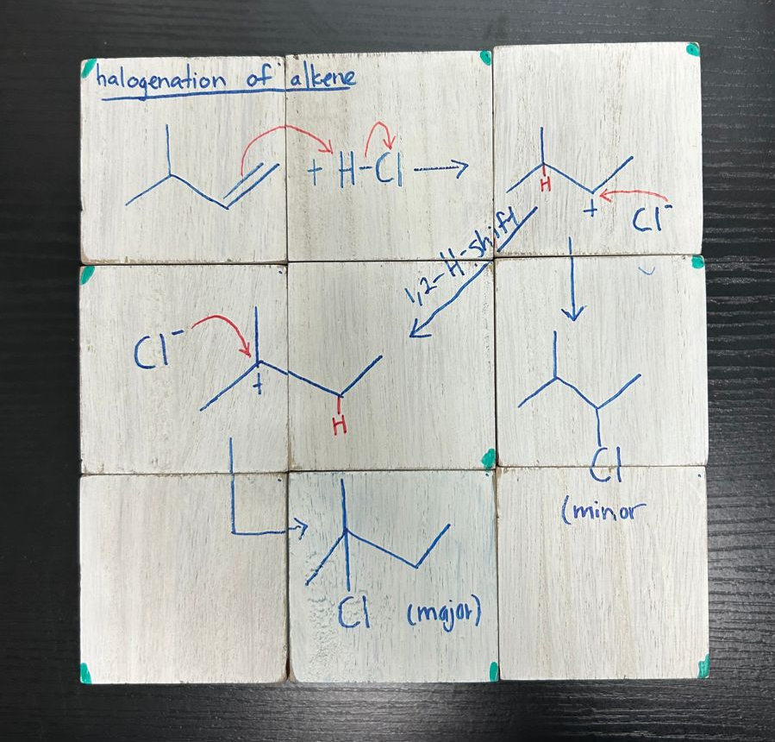
ChemBlock
Chemblock consist of 9 cubes of 6 sides. On each side, is a portion of mechanism where when combined with the other 9 cubes, will create a complete mechanism. Each topic was colour coded at one edge to make it much easier to be assembled. The topics that were included are:
Halogenation of alkanes
Dehydration of alcohols
Halogenation of alkenes
Hydration of alkenes
Nitration of benzene
S_{N}1 and S_{N}2 mechanism

Slide 6
Research Methodology
Two sets of mechanism quiz questions were given within a period of four weeks.
The 1st week, the mechanism was introduced and the 2nd week, the first set of mechanism quiz was given.
The 3rd week, another mechanism was introduced followed by another quiz on 4th week.
Students in the ChemBlock group were allowed to play around with the ChemBlock a day before the questions being given to the whole class.

Slide 7
1st cycle
ChemBlock group |  | Control |  |  | ChemBlock group |  | Control
K4T7a |  | K4T7b |  |  | K4T8b |  | K4T8a
No. of students | Marks | No. of students | Marks |  | No. of students | Marks | No. of students | Marks
1 | 5 | 0 | 5 |  | 0 | 5 | 0 | 5
1 | 4 | 2 | 4 |  | 1 | 4 | 0 | 4
3 | 3 | 0 | 3 |  | 3 | 3 | 0 | 3
0 | 2 | 3 | 2 |  | 2 | 2 | 3 | 2
1 | 1 | 1 | 1 |  | 0 | 1 | 2 | 1
0 | 0 | 0 | 0 |  | 0 | 0 | 1 | 0
83% |  | 33.33% |  |  | 67% |  | 0%

Slide 8
2nd cycle
ChemBlock group |  | Control |  |  | ChemBlock group |  | Control
K4T7a |  | K4T7b |  |  | K4T8b |  | K4T8a
No. of students | Marks | No. of students | Marks |  | No. of students | Marks | No. of students | Marks
0 | 10 | 0 | 10 |  | 0 | 10 | 0 | 10
1 | 9 | 0 | 9 |  | 0 | 9 | 0 | 9
0 | 8 | 0 | 8 |  | 3 | 8 | 0 | 8
3 | 7 | 1 | 7 |  | 0 | 7 | 0 | 7
1 | 6 | 0 | 6 |  | 0 | 6 | 0 | 6
0 | 5 | 0 | 5 |  | 0 | 5 | 1 | 5
0 | 4 | 3 | 4 |  | 1 | 4 | 3 | 4
1 | 3 | 1 | 3 |  | 0 | 3 | 0 | 3
0 | 2 | 0 | 2 |  | 0 | 2 | 0 | 2
0 | 1 | 1 | 1 |  | 2 | 1 | 2 | 1
0 | 0 | 0 | 0 |  | 0 | 0 | 0 | 0
66.67% |  | 16.67% |  |  | 50% |  | 0%

Slide 9
Final exam Peperiksaan Semester Program Matrikulasi (PSPM)
ChemBlock group |  | Control
K4T7a |  | K4T7b
A- and A |  | A- and A
83% |  | 43%
ChemBlock group |  | Control
K4T8b |  | K4T8a
A- and A |  | A- and A
57% |  | 33%

Slide 10
Improvements
Can be applied to reactions of organic chemistry
Digitalised the cube into AI apps
Students took a long time to assemble the cube

Slide 11
Conclusion
It can be concluded that ChemBlock were able to aid in helping students to memorize the organic mechanism.
Students were able to understand the direction of arrow movement and the intermediates form in the mechanism steps.
It can also be concluded the ChemBlock were able to aid students’ achievement in their final exam.

Slide 12
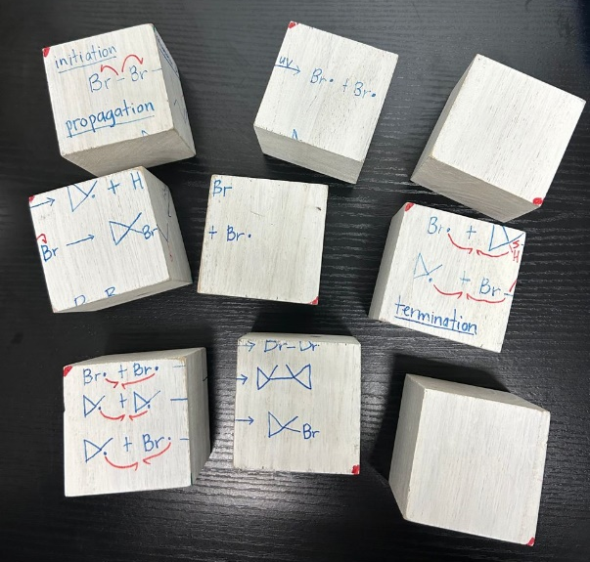
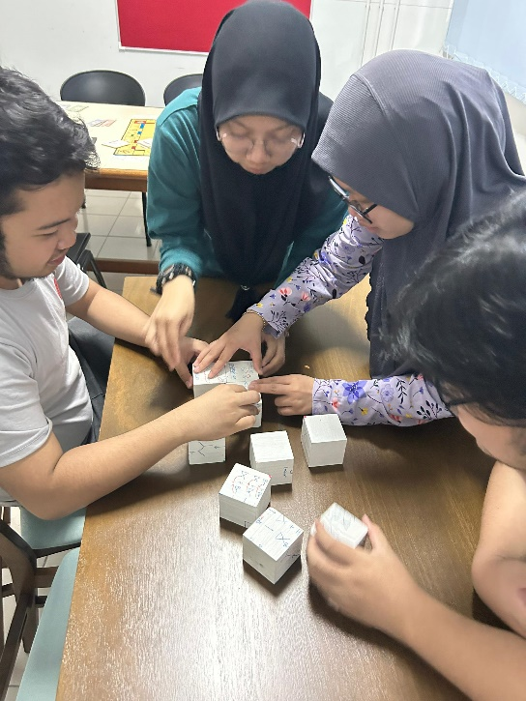

Slide 13
